Slide 1
Library Management System
Project by
Nahidul Islam Shakin
ID : 18CSE246
Project Supervisor
Faruk Hossen
Assistant Professor

Slide 2
Welcome to my presentation

Slide 3
Introduction
My project title is “Library Management System”
This project is based on Web using Bootstrap in front end and in Back end Django and SQL3 for database.
This project is mainly for managing the library’s books.
Student and Library’s admin are the user of this WebApp.
Students can take books easily and get new books as they demand in future.

Slide 4
Purpose
Addressing challenges in traditional library management.
Streamline cataloging and tracking of library books for easy organization.
Provide an intuitive interface for librarians, enhancing usability.
Simplify member management, from registration to communication.
Utilize Django for a secure, maintainable, extensible solution.

Slide 5
Key features
Book Cataloging : Efficient organization of books with details.
Student : Easy registration and status tracking.
User-Friendly Interface : Intuitive for library usage and trends.
Report Download : Admin can download students, books, issued books information for making data report.
Fine : After expire date fine will automatically added to user’s that issued book.

Slide 6
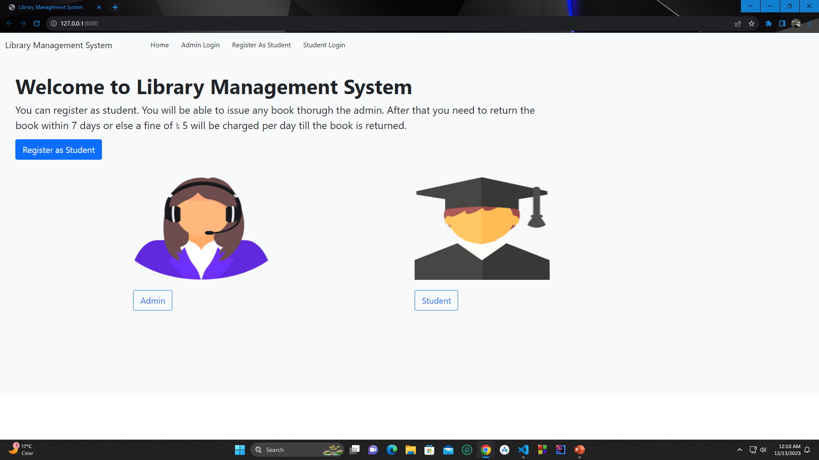

Slide 7
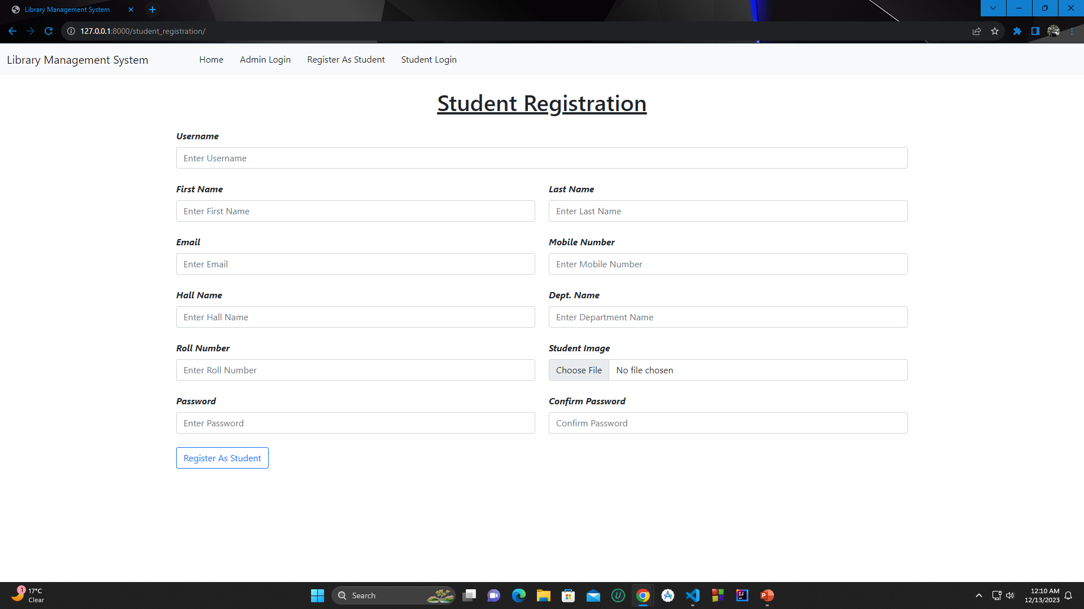

Slide 8
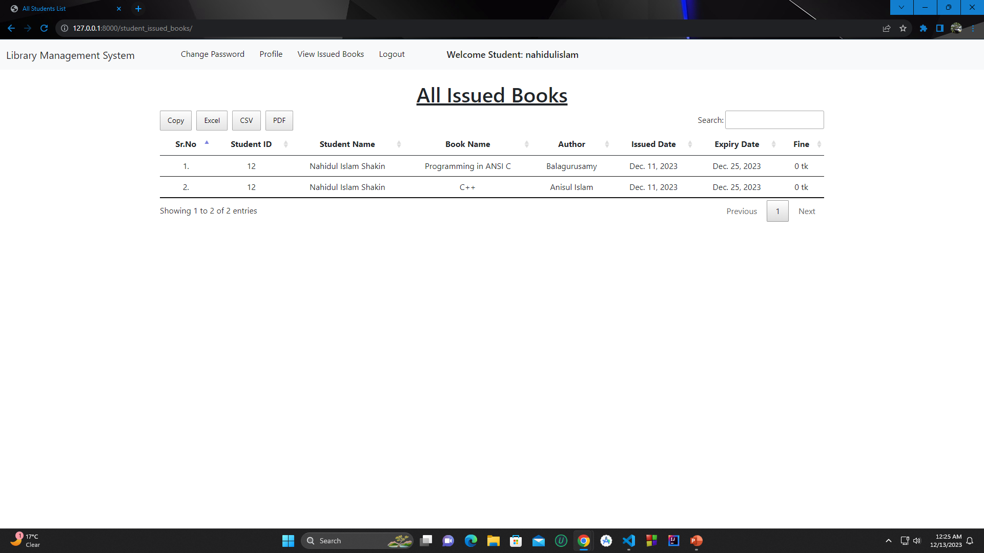

Slide 9
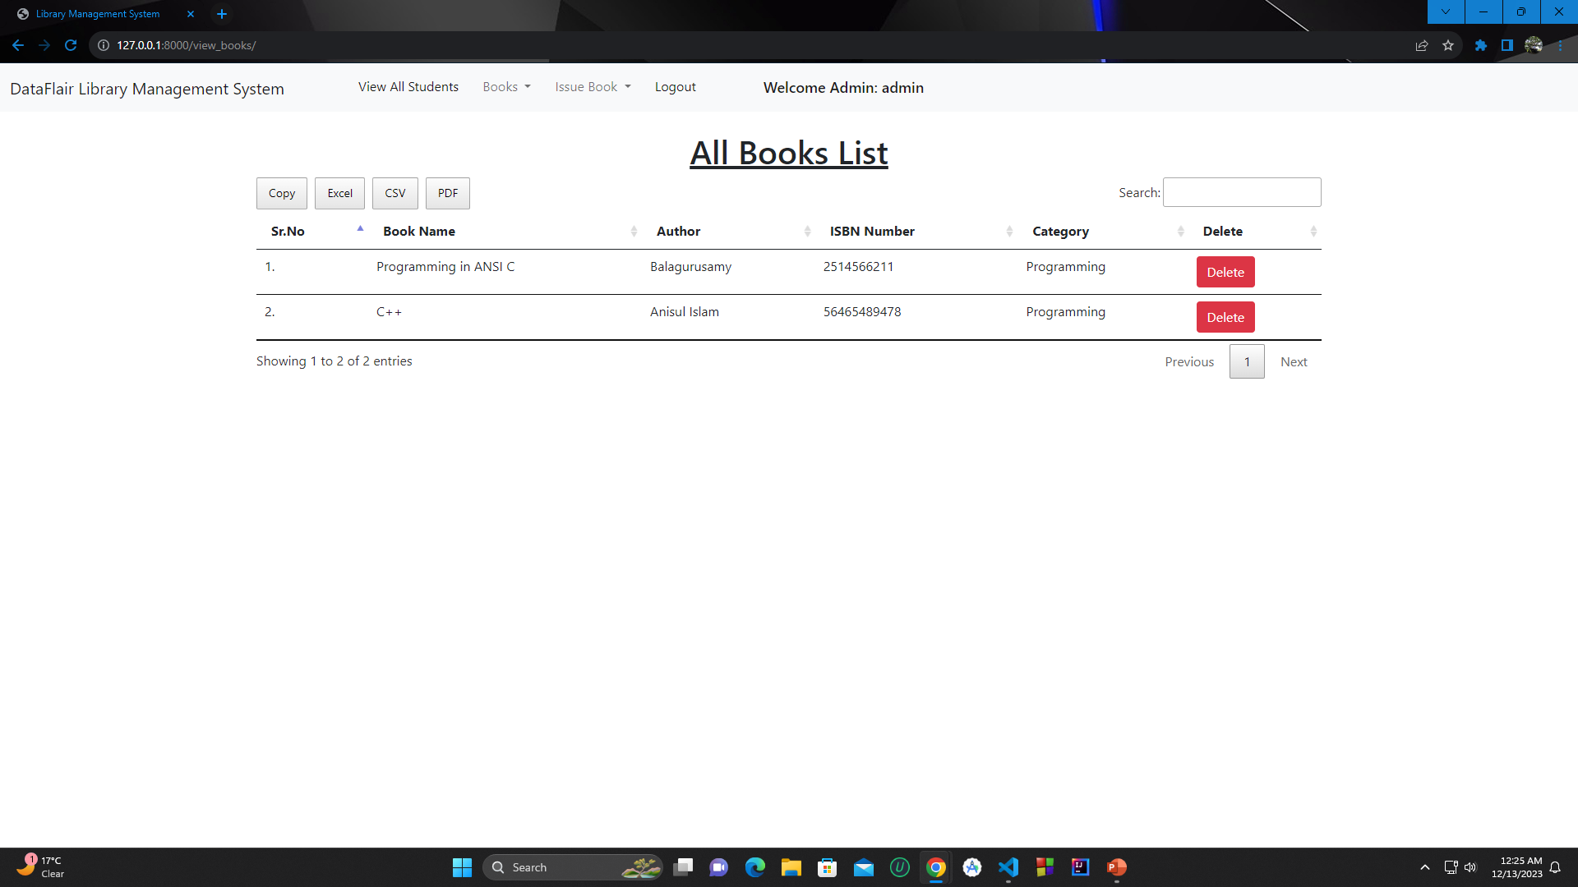

Slide 10
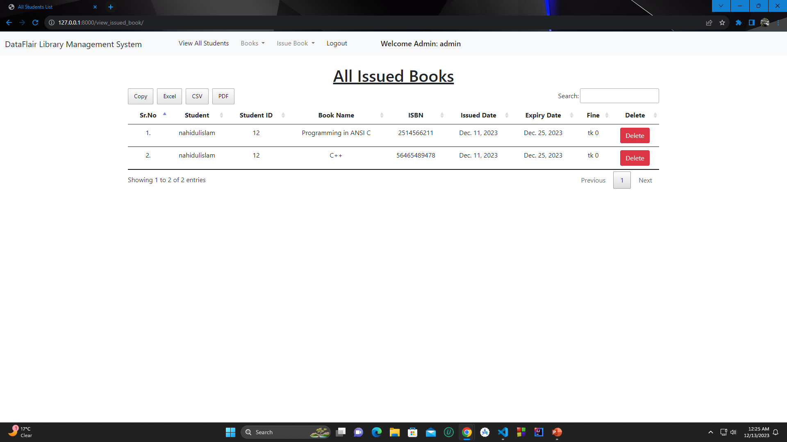

Slide 11
Conclusion
In closing, we’ve explored a solution designed to revolutionize library management.
From streamlined book transactions to powerful analytics, our system aims to redefine efficiency.
Our system directly addresses challenges, making library management a seamless and enjoyable process.
As we look ahead, the system is not just a solution but a foundation for continuous improvement.

Slide 12
Reference
https://www.w3schools.com/python/
https://www.w3schools.com/django/
https://www.w3schools.com/bootstrap/

